Slide 1
TRANSITION TO LOW-CARBON CEMENT-BASED CONSTRUCTION IN INDIA – INNOVATION IMPERATIVES AND OBSTACLES
DR ANJAN K CHATTERJEE
ICI-IWC CONFERENCE, BANGALORE
20 SEPTEMBER 2018

Slide 2
COMPARISON OF CEMENT, STEEL AND PLASTIC PRODUCTION IN THE WORLD (Henry Van Damme, CCR, 2018)
Production
Per capita
consumption

Slide 3
APPROXIMATE VOLUME EXPANSION OF CEMENT BASED BUILDING MATERIALS FROM THE CEMENT PRODUCTION BASE
Cement
4.5 BT
BUILDING MATERIALS
30 BT
Concrete without metal
14 BT
RCC
6 BT
All others
12 BT

Slide 4
COMPARATIVE CO2 EMISSION ESTIMATES (WITHOUT HEATING/COOLING/LIGHTING ENERGY)
Materials factors | Cement as produced | Derived building materials
Production, BT | 4.5 | 30
CO2 emission, BT | 3.2 | 2.7
Assumption | 0.7 T/T | 0.09 T/T

Slide 5
CEMENT BASED MATERIALS SCENARIO IN INDIA
Annual cement production capacity (Sep 2017): 425 Mt
Corresponding production due to low demand: 280 Mt
Improving trend of demand and with even 90% capacity utilization the annual production may exceed 380 Mt
Cement based building materials production range:
1.8 – 2.5 Bt
Structural concrete application estimated at
1.2 Bt – 1.6 Bt
Approximate quantity of RCC: 300 – 400 Mt (20 – 33%)

Slide 6
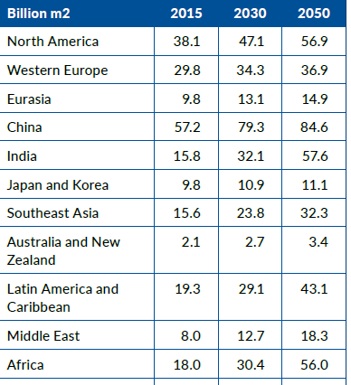
BUILDING FLOOR AREA GROWTH BY 2050 IN DIFFERENT REGIONS
World Total (Bm2) 223.5 315.5 415.1

Slide 7
GLOBAL FINAL ENERGY CONSUMPTION IN 2014 (GABC)

Slide 8
GLOBAL EMISSION SHARE IN 2014
(GABC)

Slide 9
GLOBAL BUILDING SECTOR - 2DC TRAJECTORY FOR TOTAL ENERGY (GABC)

Slide 10
BASIC STRATEGIES FOR CO2 EMISSION REDUCTION FROM CONCRETE IN INDIA AND OTHER COUNTRIES
Reduce CO2 emission
Use cement with low clinker factor
Use less cement in making concrete
Use less concrete in construction
Use recycled coarse and fine aggregates

Slide 11
STEPS TOWARDS MAKING CEMENT WITH LOW CLINKER FACTOR IN INDIA
Step 1
Normal Portland Cement with 5% Filler & 5% Gypsum
About 90% Clinker in Cement
Step 2
Blended Portland Cement with Single Blending Material
About 55-70% Clinker (Except PSC with Cl 35-45%)
Step 3
Portland Cement with Multiple Blending Materials
About 45-50% Clinker in Cement

Slide 12
COMPOSITE CEMENT – IS16415:2015
Portland cement clinker/OPC (IS 16353): 35-65%
Fly ash (IS 3812 PT I) : 15-35%
Granulated slag (IS 12089): 20-50%
[Process of co-grinding or blending of fine powders for a product passing 300 Blaine surface]

Slide 13
Present Limitations of the Standard Specification
Very limited types of supplementary cementitious materials permitted.
Widely available and proven materials like silica fume, calcined clay (metakaolin) and limestone left out.
Fundamental principle of blending materials of widely differing psds not factored into the standard.
Studies are focussed only on testing and not on making the composite cements of superior performance and application-friendly.

Slide 14
PROJECTED CLINKER FACTOR TREND

Slide 15
ILLUSTRATIVE COMPARISON OF EMBODIED CO2e FROM CEMENT & SCMs IN M30 CONCRETE
Figures in (kg/m3)
Parameter | No SCM | 30% Fly ash | 50% Ggbs | 70% Ggbs
Total cm | 320 | 360 | 330 | 370
OPC | 320 | 250 | 165 | 110
Fly ash | - | 110 | - | -
Ggbs | - | - | 165 | 260
CO2-e | 292 | 228 | 161 | 117

Slide 16
PRESENT APPROACH TOWARDS DERIVING COMBINED BENEFITS OF SCMs & CHEMICAL ADMIXTURES
Use of cement is coupled with low w/cm and the availability of more fines in concrete mixes
Some illustrations:
Normal concrete with cement content of
350 kg/m3 and w/c ratio in the range 0.4 - 0.6 yielding 25-30 Mpa at 28 days
HPC with cement content of +450 kg/m3 and silica fume with w/cm ratio of 0.32-0.35 yielding 60 Mpa at 28 days
UHPC with cement content of 650-700 kg/m3 , silica fume and other selected fines with w/cm ratio maintained below or close to 0.2 yielding 200 Mpa
Does this approach take care of the space-filling character of the hydrates?

Slide 17
INNOVATION ESSENCE FOR ‘LESS CEMENT - BETTER CONCRETE’ STRATEGY
Fresh concrete
PSD
Particle dispersion
Set & hardened concrete
Gel space ratio
Binder intensity index
Particle packing
Rheology
Particle packing density
Age-strength optimization

Slide 18
LESS CEMENT FOR BETTER PERFORMING CONCRETE – MODELING APPROACH
Therodynamic modeling
Multiscale micromechanical modeling
Kinetic modeling

Slide 19
DIRECTION TOWARDS REDUCING CEMENT CONTENT IN CONCRETE ELEMENTS ( F J Ulm, Beton and Stahlbeton Bau, 2012)

Slide 20
GENERATION OF CONSTRUCTION & DEMOLITION WASTES – SITUATION IN INDIA (Source: TIFAC)
Constituents | Quantity generated ( Million tpa)
Soil, sand and gravel | 4.20 – 5.15
Bricks and masonry | 3.60 – 4.40
Concrete | 2.40 – 3.67
Metal | 0.60 – 0.73
Bitumen | 0.25 – 0.30
Wood | 0.25 – 0.30
Others | 0.10 – 0.15 Note: 50% recycled

Slide 21
CONCRETE RECYCLING TECHNOLOGY – PRESENT STATUS IN INDIA
Extremely poor awareness of the global progress and practices in the industry.
Sporadic and uncoordinated exploratory research.
Confluence of plant – process – products not achieved.
The dusty fine fraction from C&D wastes not at all in the reckoning of application.
Codes, regulations & policies are yet to be firmed up.

Slide 22
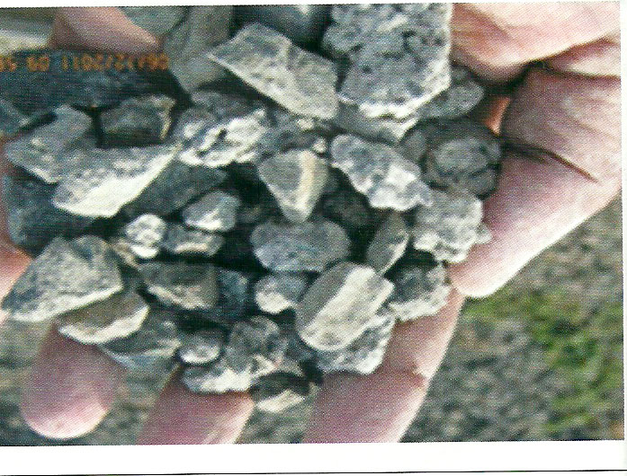
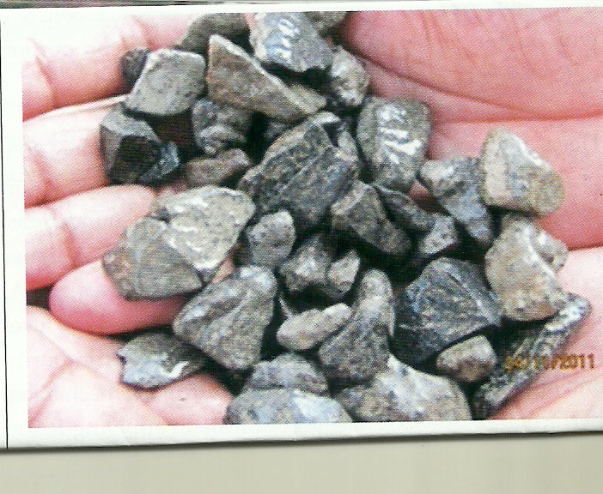
CAN THE PARTIAL SUBSTITUTION OF NATURAL AGGREGATES BY RECYCLED AGGREGATE BE MADE MANDATORY?
(Unprocessed aggregate on the left & processed on the right)

Slide 23
BEYOND THE BASICS OF CONCRETE TECHNOLOGY FOR LOW CARBON TRANSITION
Refurbishment vs new build
Steel rebar-free concrete
Novel materials towards zero-emission buildings

Slide 24
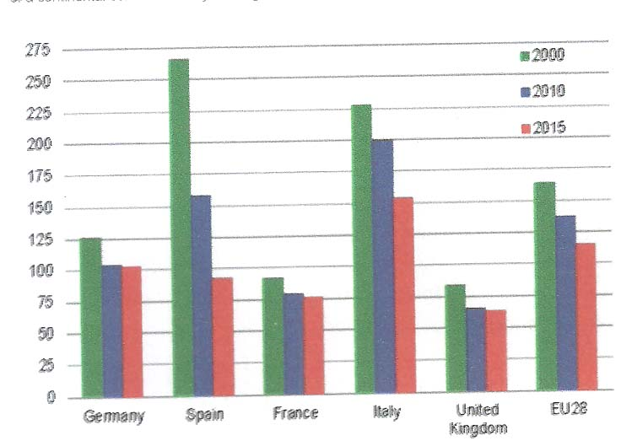
LOWER CEMENT CONSUMPTION PATTERNS IN SOME EU COUNTRIES WITH EMPHASIS ON LIFE EXTENSION OF STRUCTURES

Slide 25
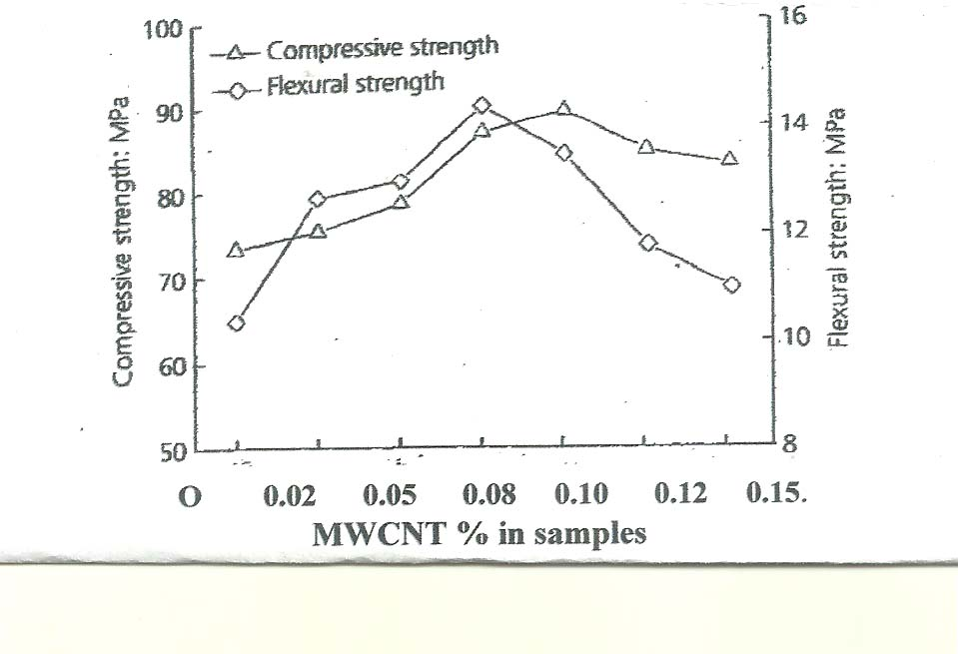
Possibility of reinforcing Cement Composites with MWCNTs: an Illustration of alternatives to rebars

Slide 26
New materials for Zero-Emission Buildings
Bio-renewable materials as carbon sink
Phase-change materials
Green roofing & repair materials

Slide 27
CONCLUSIVE REMARKS
Transition to low-carbon concrete construction requires multidisciplinary approach.
Cement-SCM-Filler-Aggregate-Admixture is a system and construction is a process.
Large volumes of construction in widely varying environment makes the tasks complex much beyond simple proportioning and testing.
Adoption of modelling at multiple scales based on actual field data is necessary.
Much innovation has happened but more is needed.

Slide 28
Thank you for your patience

